Slide 1
CptS 327
Anonymity (Tor and Signal)
Notes:
Template-WSU Hrz 201.ppt

Slide 2
Today’s Topics
Overview
  Anonymity
    VPNs
    Tor
      Onion routing
    Signal
      Double Ratchet
Notes:
Template-WSU Hrz 201.ppt

Slide 3
Anonymity
State of being anonymous i.e., unidentified
Pros
  Privacy
  Tends to enhance freedom in the form of free speech
Cons
  Undermines authority
  Tends to promote activities considered illegal
Notes:
Template-WSU Hrz 201.ppt

Slide 4
Anonymity
Proponent
  ‘My affairs are no one’s business, not even the govt.’
Opponent
  ‘Monitoring protects the nation. Lawful citizens have no cause to be worried’
Case studies
  PRISM: global surveillance program by the NSA
    Claimed co-op: Google, Microsoft, Facebook, Apple, Dropbox, Yahoo
  Operation Onymous: darknet busting by FBI, Europol, DHS, and ICE
    Dismantled Silk Road, Cloud 9, and Hydra drug darknets
    Claim to have dismantled $50 million worth of darknet operations
Notes:
Template-WSU Hrz 201.ppt

Slide 5
Anonymity
Total anonymity
  No use of IDs (usernames etc.)
  Total anonymity impossible in modern computing systems
    Even with cutting edge encryption, you’re vulnerable at end points
Reasonable anonymity
  Privacy focused services
    Email: protonmail
    Browsing: Tor
    VPNs: Tor
    Messaging / video calling: Signal, Session
    OS: Tails
Notes:
Template-WSU Hrz 201.ppt

Slide 6
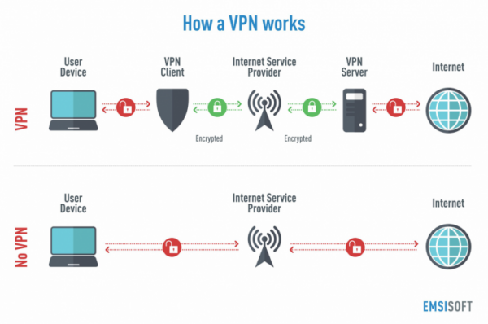
Virtual Private Networks (VPNs)
Creates a tunnel within a network
  Devices connected to a VPN are treated as if on the VPN’s network
  Encryption of traffic in VPNs is common but not a requirement
Notes:
Template-WSU Hrz 201.ppt

Slide 7
Virtual Private Networks (VPNs)
VPNs work best for providing
  Stability to wireless connections
    E.g. ping values are stabilized when using a VPN over wireless
  Functionality and licensure of VPN provider
    E.g. ‘A’ is your ISP; ‘B’ is your VPN
      ‘A’ doesn’t have IEEE license; ‘B’ does
      By using ‘B’ VPN, you’ll be able to access IEEE
        Even though ‘A’ is still your ISP
Theoretically, one can tunnel as many times as they want
  A → B → C → … → N
Practically, your tunnel limit depends on your ISP’s bandwidth
  #Tunnels = Bandwidth (A)
Notes:
Template-WSU Hrz 201.ppt

Slide 8
Virtual Private Networks (VPNs)
VPNs are not reliable for anonymity
  Using a VPN will safeguard from ISP’s traffic monitoring
  But the VPN is still monitoring your traffic
    Most VPN providers are subject to local laws
    They will provide your traffic info to authorities with a warrant
Notes:
Template-WSU Hrz 201.ppt

Slide 9
Tor
‘The Onion Router (TOR)’ anonymity project; started in 2002
Free and open source (FOSS)
Provides anonymous communication over the internet
  Uses a routing protocol known as ‘Onion Routing’
Makes it hard, not impossible, to perform
  Network surveillance
  Traffic analysis
Uses a global overlay network of volunteer router relay nodes
  7000+ volunteer relays as of Nov 2021
  https://metrics.torproject.org/
Notes:
Template-WSU Hrz 201.ppt

Slide 10
Tor
Project’s fiscal sponsors include Google, Cambridge, DARPA
The good
  Protects human rights in tyrannical regimes
    Whistleblowers, activism, internet browsing freedom etc
The bad
  Provides a platform to market illegal operations
    Drugs, black hat hackers, fraud, counterfeit, guns etc
The ugly
  Provides a platform for inhumane activities
    Child pornography, human trafficking, extremism / terrorism
https://doi.org/10.1080/00396338.2016.1142085
Notes:
Template-WSU Hrz 201.ppt

Slide 11
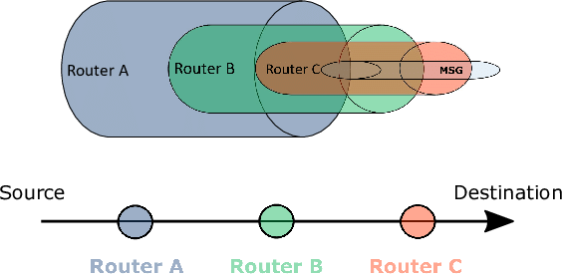
Onion Routing
Notes:
Template-WSU Hrz 201.ppt

Slide 12
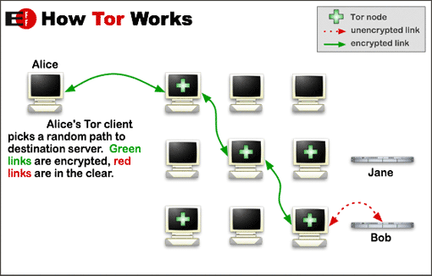
Onion Routing - Tor
Notes:
Template-WSU Hrz 201.ppt

Slide 13
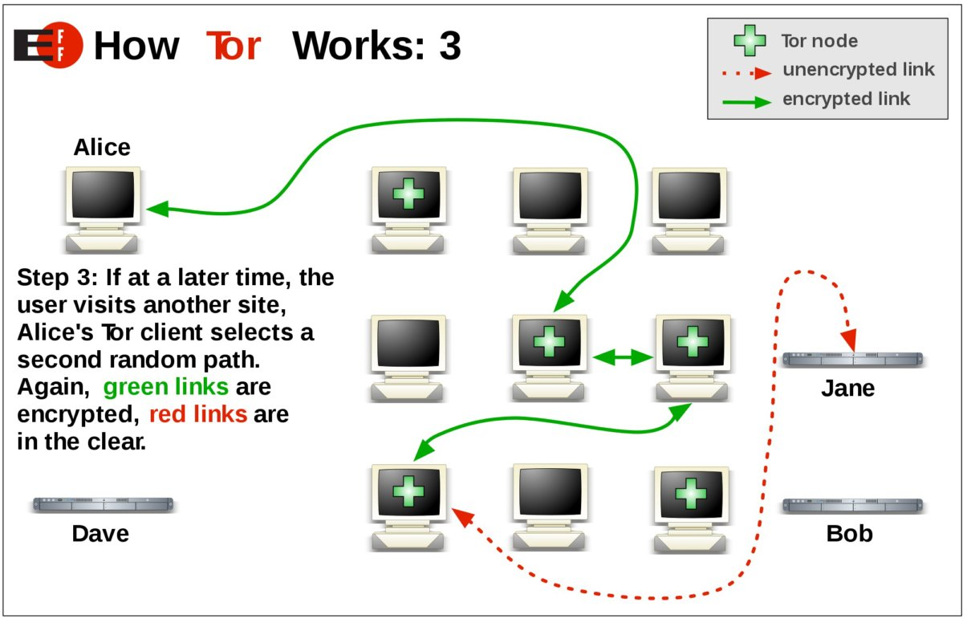
Onion Routing - Tor
Notes:
Template-WSU Hrz 201.ppt

Slide 14
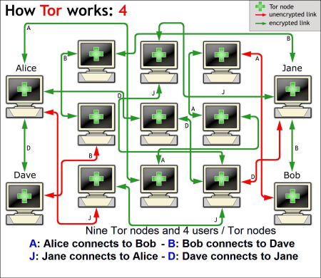
Onion Routing - Tor
Notes:
Template-WSU Hrz 201.ppt

Slide 15
Onion Routing - Tor
Garlic Routing?
Notes:
Template-WSU Hrz 201.ppt

Slide 16
Onion Routing
Vulnerabilities
  Traffic timing analysis
    Monitoring the onion overlay network, leverage
      Traffic patterns
      Timing patterns
    Data itself is secure but source and destination IDs are not
  Exit node vulnerability
    Final node always decrypts info before delivering to recipient
    Compromised exit node is a serious issue
      NSA’s EgotisticalGiraffe
  Operation Onymous
      Speculated to be DDoS + Sybil
Notes:
Template-WSU Hrz 201.ppt

Slide 17
Signal
RedPhone and TextSecure projects merged in 2014
FOSS
Provides end to end (E2E) encryption
  Text messaging (TextSecure)
  Voice calling (RedPhone)
Signal Protocol
  Uses Double Ratchet algorithm for initial key sharing
    Triple Diffie Hellman (3XDH) for handshake
    AES-256, HMAC-SHA256, and Curve 25519 for bulk
  Enables CIA, secrecy, repudiation, and asynchronous operations
  Used by many apps: MS Skype, FB Messenger, Google Allo
Notes:
Template-WSU Hrz 201.ppt

Slide 18
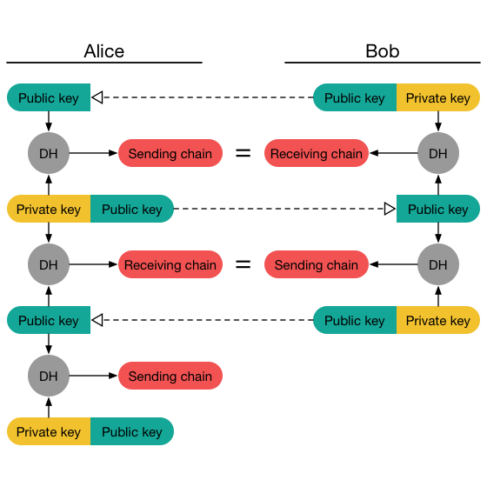
Double Ratchet
Notes:
Template-WSU Hrz 201.ppt

Slide 19
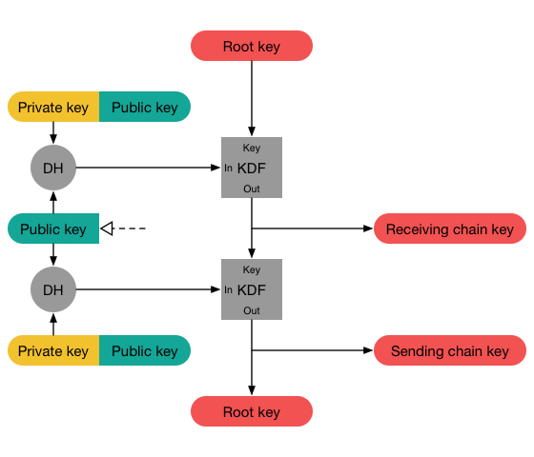
Double Ratchet
Notes:
Template-WSU Hrz 201.ppt

Slide 20
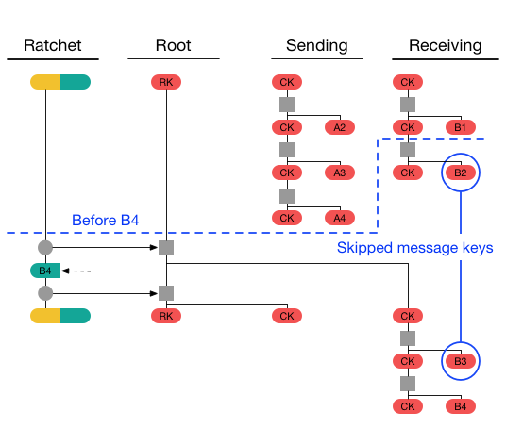
Double Ratchet
Notes:
Template-WSU Hrz 201.ppt

Slide 21
Signal Protocol
Vulnerabilities
  Theoretical
    Compromising one end in E2E encryption
  Practical
    MAC bypass due to Android / iOS bugs
    DoS
    Third party code injection (XSS)
Notes:
Template-WSU Hrz 201.ppt

Slide 22
Next lecture
Blockchain
Notes:
Template-WSU Hrz 201.ppt

Slide 23
Any questions?
Notes:
Template-WSU Hrz 201.ppt

